Slide 1

Customer Shopping Behaviour Analysis
Uncovering insights from 3,900 purchases to drive strategic business decisions

Slide 2
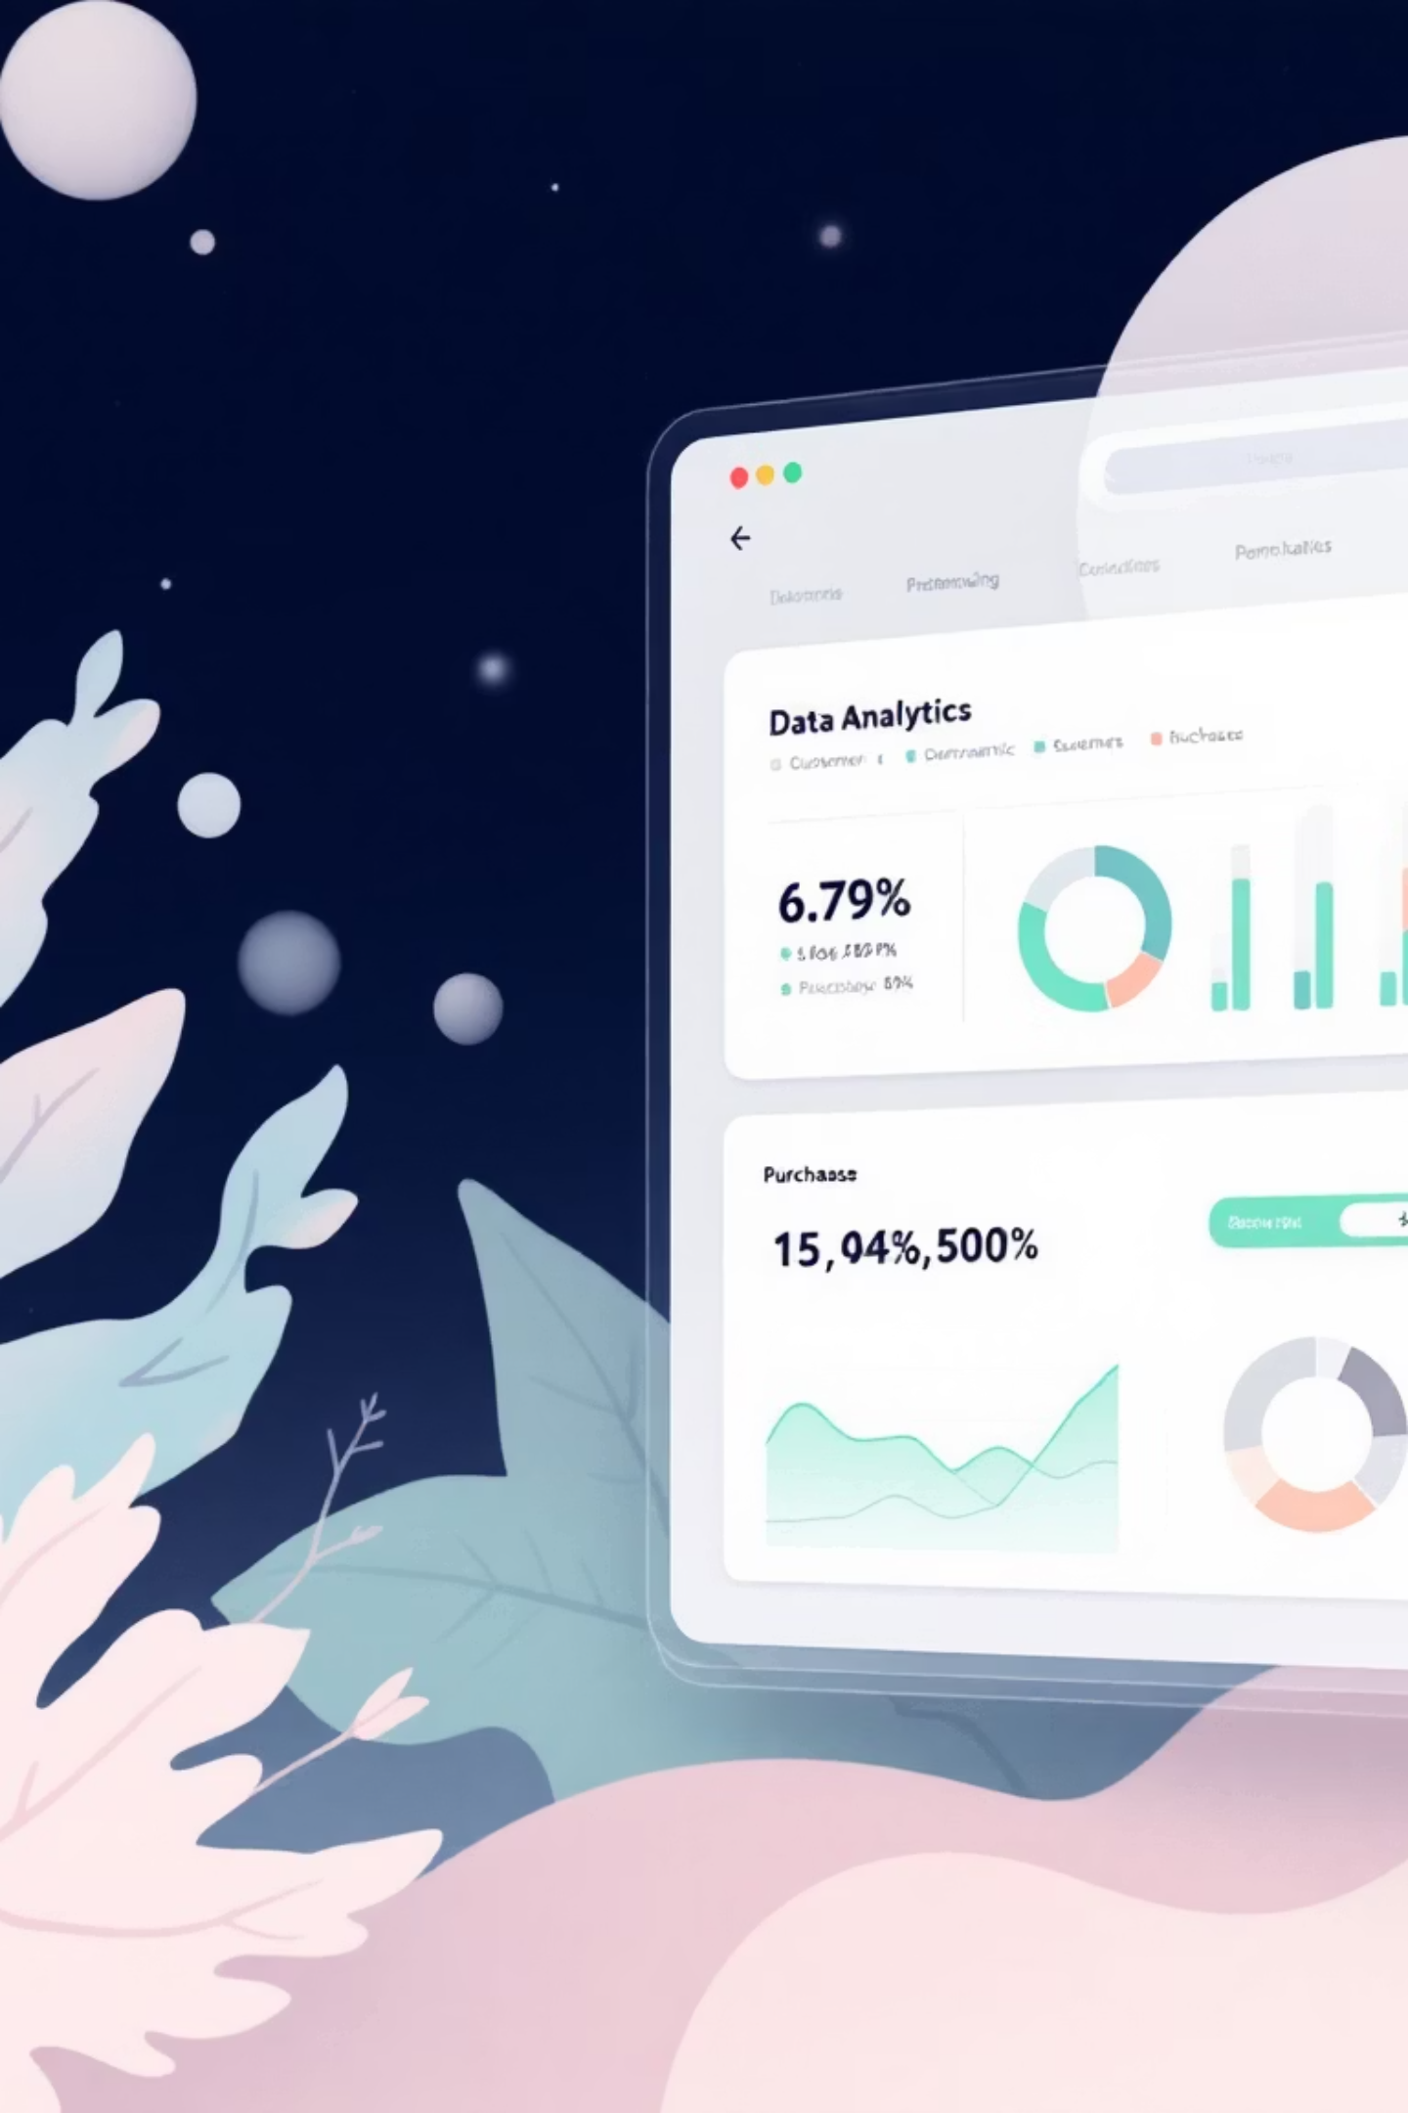
Dataset at a Glance
3,900
18
37
Total Purchases
Data Columns
Missing Values
Transactions analyzed
Feature dimensions
Review ratings only
Customer Demographics
Purchase Details
Item, Category, Amount
Age, Gender, Location
Season, Size, Color
Subscription Status

Slide 3
Data Preparation in Python
01
02
03
Data Loading & Exploration
Missing Data Handling
Column Standardization
Imported dataset, checked structure with df.info() and summary statistics
Imputed Review Rating nulls using median rating per product category
Renamed columns to snake_case for better readability
04
05
Feature Engineering
Database Integration
Created age_group and purchase_frequency_days columns
Connected to PostgreSQL and loaded cleaned data for SQL analysis

Slide 4

Revenue Insights
Gender Revenue Split
Male vs. female customer spending comparison reveals key demographic patterns
High-Spending Discount Users
Customers using discounts but spending above average purchase amount

Slide 5


Product Performance
Top 5 Products by Rating
Highest average review ratings identify customer favorites and quality leaders
Discount-Dependent Products
5 products with highest percentage of discounted purchases show price sensitivity

Slide 6

Shipping & Subscription Analysis
Shipping Type Comparison
Subscribers vs. Non-Subscribers
Standard vs. Express: Average purchase amounts differ significantly by delivery preference
Average spend and total revenue comparison reveals subscription program impact
Repeat Buyers & Subscriptions
Customers with >5 purchases show higher subscription likelihood

Slide 7




Customer Segmentation
Returning
Repeat purchasers building habits
New Customers
First-time buyers entering the funnel
Loyal Segment
High-frequency buyers driving revenue
Classification based on purchase history reveals customer lifecycle patterns and retention opportunities

Slide 8


Category & Age Insights
Top 3 Products per Category
Revenue by Age Group
Most purchased items within each product category identify bestsellers
Total revenue contribution across age segments reveals demographic value

Slide 9

Power BI Dashboard
Interactive visual analytics bringing insights to life
Real-Time Metrics
Live tracking of key performance indicators
Dynamic Filtering
Drill down by category, demographics, time
Executive Views
Stakeholder-ready visualizations

Slide 10
Strategic Recommendations
Boost Subscriptions
Loyalty Programs
Review Discount Policy
Promote exclusive benefits for subscribers
Reward repeat buyers to move into "Loyal" segment
Balance sales boosts with margin control
Targeted Marketing
Product Positioning
Focus on high-revenue age groups and express-shipping users
Highlight top-rated and best-selling products in campaigns

